Slide 1
A Nearly Tight Sum-of-Squares Lower Bound for the Planted Clique Problem
Aaron Potechin
Institute for Advanced Study

Slide 2
Talk Outline
Part I: Introduction/Motivation
Part II: A game for Sum of Squares (SoS)
Part III: SoS on general equations
Part IV: Pseudo-calibration
Part V: Brief Proof Overview
Part VI: Future Work

Slide 3
Part I: Introduction/Motivation

Slide 4
Goal of Complexity Theory
Fundamental goal of complexity theory: Determine the computational resources (such as time and space) needed to solve problems
Requires upper bounds and lower bounds

Slide 5
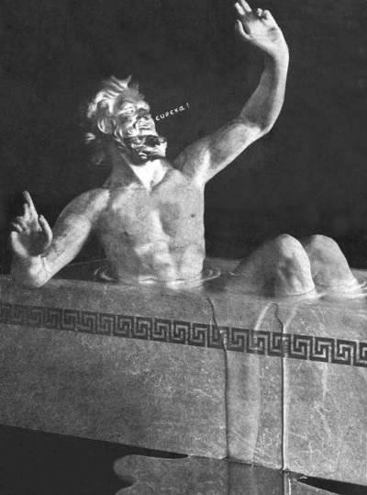
Upper Bounds
Requires finding a good algorithm and analyzing its performance.
Traditionally requires great ingenuity (but stay tuned!)

Slide 6
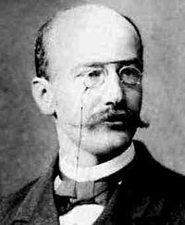
Lower Bounds
is impossible!
Requires proving impossibility
Notoriously hard to prove lower bounds on all algorithms (e.g. P versus NP)
If we can’t yet prove lower bounds on all algorithms, what can we do?

Slide 7
Lower Bounds: What we can do
is impossible!
Path #1
Conditional Lower Bounds: Assume one lower bound, see what follows (e.g. NP-hardness)
Path #2
Restricted Models: Prove lower bounds on restricted classes of algorithms
Both paths give a deep understanding and warn us what not to try when designing algorithms.

Slide 8
My Work
My work: Analyzing restricted classes of algorithms (path #2).
This talk: Lower bounds for the Sum of Squares (SoS) Hierarchy

Slide 9
Why Sum of Squares (SoS)?
Broad: Meta-algorithm (framework for designing algorithms) which can be applied to a wide variety of problems.
Effective: Surprisingly powerful. Captures several well-known algorithms (max-cut [GW’95], sparsest cut [ARV’09], unique games [ABS’10]) and is conjectured to be optimal for many combinatorial optimization problems!
Simple: Essentially only uses the fact that squares are non-negative over the real numbers.

Slide 10
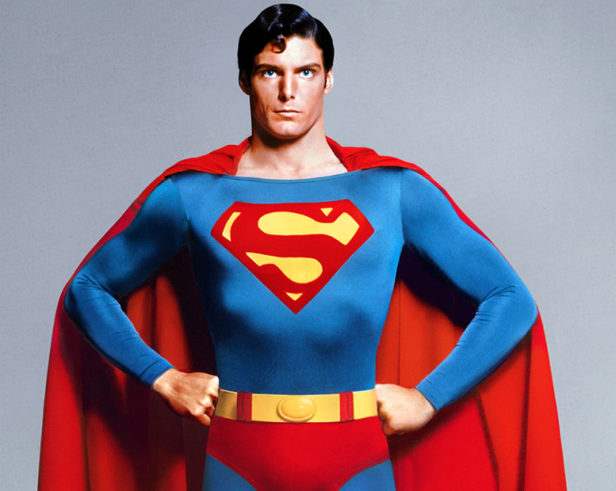
SoS Applications
Quantum Information Theory
Robotics and Control Theory
Game Theory
Machine Learning
Formal Verification
Sum of Squares Hierarchy

Slide 11
Why prove SoS Lower Bounds?
Unconditional lower bounds
Gives a deep understanding of SoS
SoS lower bounds rule out all algorithms captured by SoS (including spectral algorithms, linear programming, and semidefinite programming), providing strong evidence of hardness

Slide 12
Known SoS Lower Bounds
Through a long line of work, we know SoS lower bounds for general CSPs (constraint satisfaction problems) and other NP-hard problems [G’99], [S’08], [T’09], [BCK’15], [DKMW’17]
These techniques are very nice, but many important problems are not constraint satisfaction problems or NP-hard problems.
Focus of this talk: Planted clique problem.

Slide 13
Planted Clique
Random instance: $G(n,\frac{1}{2})$
Planted instance: $G\left(n,\frac{1}{2}\right)+K_{k}$
Example: Which graph has a planted 5-clique?
a
b
a
b
j
c
j
c
i
d
i
d
h
e
h
e
g
f
g
f

Slide 14
Planted Clique
Random instance: $G(n,\frac{1}{2})$
Planted instance: $G\left(n,\frac{1}{2}\right)+K_{k}$
Example: Which graph has a planted 5-clique?
a
b
a
b
j
c
j
c
i
d
i
d
h
e
h
e
g
f
g
f

Slide 15
Planted Clique Connections
Nash Equilibrium
Cryptography
Molecular Biology Signals
Mathematical Finance
Compressed Sensing
Property Testing
Planted Clique

Slide 16
Planted Clique Bounds
$$2^{n}$$
Solvable with brute force search
Time
$$n^{Ω(\log{n)}}$$
Solvable with spectral algorithm [AKS’98]
SoS?
$$n^{O(1)}$$
$$O(1)$$
$$2log⁡(n)$$
$$\sqrt{n}$$
$$n$$
Planted Clique size
Information-theoretically impossible
Lower bounds known for other models [J’92],[FK’03],[FGRVX’13]

Slide 17
SoS Planted Clique Bounds
$$2^{n}$$
Solvable with brute force search
Time
$$n^{Ω(\log{n)}}$$
Solvable with spectral algorithm [AKS’98]
$$n^{O(1)}$$
Almost tight lower bound
[BHKKMP’16]
$$O(1)$$
$$2log⁡(n)$$
$$\sqrt{n}$$
$$n$$
Planted Clique size
Information-theoretically impossible
First SoS lower bounds
[MPW’15],[DM’15],[HKPRS’16]

Slide 18
Upcoming Results
Machinery applies more generally to planted problems, not just to planted clique.
Planted Problems: Can we distinguish between a random instance and a random instance plus a planted solution?
[HKPRSS,upcoming]:
Almost tight ($2^{(n^{Ω(1)})}$ time) lower bounds for tensor PCA and sparse PCA, two planted problems of interest in machine learning
More general conditions implying SoS lower bounds on planted problems

Slide 19
Part II: A Game for Sum of Squares (SoS)

Slide 20
Distinguishing via Equations
Recall: Want to distinguish between a random graph and a graph with a planted clique.
Possible method: Write equations for k-clique (k=planted clique size), use a feasibility test to determine if these equations are solvable.
SoS gives a feasibility test for equations.

Slide 21
Equations for $k$-Clique
Variable $x_{i}$ for each vertex i in G.
Want $x_{i}=1$ if i is in the clique.
Want $x_{i}=0$ if i is not in the clique.
Equations:
$x_{i}^{2}$ = $x_{i}$ for all i.
$x_{i}$ $x_{j}$ = 0 if $\left(i,j\right)∉E(G)$
$\sum_{i}{x_{i}}$ = $k$
These equations are feasible precisely when G contains a $k$-clique.

Slide 22
A Game for the Sum of Squares Hierarchy
SoS hierarchy: feasibility test for equations, expressible with the following game.
Two players, Optimist and Pessimist
Optimist: Says answer is YES, gives some evidence
Pessimist: Tries to refute Optimist’s evidence
SoS hierarchy computes who wins this game (with optimal play)

Slide 23
What evidence should we ask for?
Choice #1: Optimist must give the values for all variables.
Checking this is easy!
How do I find what the variables are?
Optimist
Pessimist

Slide 24
What evidence should we ask for?
Choice #2: No evidence at all.
Yeah, that’s solvable!
How do I show this is unsolvable?
Optimist
Pessimist

Slide 25
What evidence should we ask for?
We want something in the middle.
Optimist’s evidence for degree d SoS hierarchy: expectation values of all monomials up to degree d over some distribution of solutions.

Slide 26
Example: Does $K_{4}$ Have a Triangle?
Recall equations:
Want $x_{i}=1$ if $i∈$ triangle, 0 otherwise.
$∀i{,x}_{i}^{2}$ = $x_{i}$
$\sum_{i}{x_{i}}$ = 3
$$x_{1}$$
$$x_{2}$$
$$x_{4}$$
$$x_{3}$$
G

Slide 27
Example: Does $K_{4}$ Have a Triangle?
One option: Optimist can take the trivial distribution with the single solution
$x_{1}=x_{2}=x_{3}=1,x_{4}=0$
and give the corresponding values
of all monomials up to degree d.
Values for $d=2$:
E[1] = 1
E[$x_{1}$] = E[$x_{2}$] = E[$x_{3}$] = 1
E[$x_{1}^{2}$] = E[$x_{2}^{2}$] = E[$x_{3}^{2}$] = 1
E[$x_{1}x_{2}$] = E[$x_{1}x_{3}$] = E[$x_{2}x_{3}$] = 1
E[$x_{4}^{2}$] = E[$x_{4}$] = 0
E[$x_{1}x_{4}$] = E[$x_{2}x_{4}$] = E[$x_{3}x_{4}$] = 0.
$$x_{1}$$
$$x_{2}$$
$$x_{4}$$
$$x_{3}$$
G

Slide 28
Example: Does $K_{4}$ Have a Triangle?
Another option: Optimist can take each of the 4 triangles in G with probability ¼
(uniform distribution on solutions)
Values for $d=2$:
E[$1$] = $1$
$∀i$, E[$x_{i}^{2}$] = E[$x_{i}$] = $\frac{3}{4}$
$∀i≠j,$ E[$x_{i}x_{j}$] = $\frac{1}{2}$
$$x_{1}$$
$$x_{2}$$
$$x_{4}$$
$$x_{3}$$
G

Slide 29
Example: Does $C_{4}$ Have a Triangle?
Recall equations:
Want $x_{i}=1$ if $i∈$ triangle, 0 otherwise.
$∀i{,x}_{i}^{2}$ = $x_{i}$
$\sum_{i}{x_{i}}$ = 3
$x_{1}x_{3}=x_{2}x_{4}=0$
Here there is no solution, so Optimist has to bluff
$$x_{1}$$
$$x_{2}$$
$$x_{4}$$
$$x_{3}$$
G

Slide 30
Optimist Bluffs
Optimist could give the following pseudo-expectation values as “evidence”:
$\tilde{E}\left[1\right]=1$
$∀i,\tilde{E}\left[x_{i}^{2}\right]=\tilde{E}\left[x_{i}\right]=\frac{3}{4}$
$\tilde{E}\left[x_{1}x_{2}\right]=\tilde{E}\left[x_{2}x_{3}\right]=\tilde{E}\left[x_{3}x_{4}\right]=\tilde{E}\left[x_{1}x_{4}\right]=\frac{3}{4}$
$\tilde{E}\left[x_{1}x_{3}\right]=\tilde{E}\left[x_{2}x_{4}\right]=0$
$$x_{1}$$
$$x_{2}$$
$$x_{4}$$
$$x_{3}$$
G

Slide 31
Detecting Lies
How can Pessimist detect lies systematically?
Method 1: Check equations!
Let’s check some: (all vertices and edges have pseudo-expectation value 3/4)
$x_{1}+x_{2}+x_{3}+x_{4}=3$
${\text{Ẽ}[x}_{1}]+{\text{Ẽ}[x}_{2}]+{\text{Ẽ}[x}_{3}]+{\text{Ẽ}[x}_{4}]=4⋅\frac{3}{4}=3$
$x_{1}^{2}+{x_{1}x}_{2}+{x_{1}x}_{3}+{x_{1}x}_{4}=3x_{1}$
${\text{Ẽ}[x}_{1}^{2}]{+\text{Ẽ}[x}_{1}x_{2}]+{\text{Ẽ}[x}_{1}x_{3}]+{\text{Ẽ}[x}_{1}x_{4}]$
$=$ 3/4 $+$ 3/4 $+$ 0 $+$ 3/4 $=$ 9/4 $=$ 3${\text{Ẽ}[x}_{1}$]
Equations are satisfied,
need something more…
$$x_{1}$$
$$x_{2}$$
$$x_{4}$$
$$x_{3}$$
G

Slide 32
Detecting Lies
How else can Pessimist detect lies?
Method 2: Check non-negativity of squares!
Ẽ[${{(x}_{1}+{ x}_{3}\text{ − }x_{2}\text{ − }x_{4}\text{) }}^{2}$] $=$
Ẽ[$x_{1}^{2}$] $+$ Ẽ[$x_{3}^{2}$] $+$ Ẽ[$x_{2}^{2}$] $+$ Ẽ[$x_{4}^{2}$]
$+$ 2Ẽ[$x_{1}x_{3}$] $\text{−}$ 2Ẽ[$x_{1}x_{2}$] $\text{−}$ 2Ẽ[$x_{1}x_{4}$]
$\text{−}$2Ẽ[$x_{3}x_{2}$] $\text{−}$ 2Ẽ[$x_{3}x_{4}$] $+$ 2Ẽ[$x_{2}x_{4}$]
$=$ 3/4 $+$ 3/4 $+$ 3/4 $+$ 3/4 $+$ 0
$\text{−}$ 3/2 $\text{−}$ 3/2 $\text{−}$ 3/2 $\text{−}$ 3/2 + 0 $=$ -3
Nonsense!
$$x_{1}$$
$$x_{2}$$
$$x_{4}$$
$$x_{3}$$
G

Slide 33
Degree d SoS Hierarchy
We restrict Pessimist to these two methods.
Optimist wins if he can come up with pseudo- expectation values Ẽ (up to degree d) which obey all of the required equations and have non-negative value on all squares.
Otherwise, Pessimist wins.
Degree d SoS hierarchy says YES if Optimist wins and NO if Pessimist wins, this gives a feasibility test.

Slide 34
Feasibility Testing with SoS
What we want:
NO
YES
Test says NO
Test says YES
Degree d SoS Hierarchy:
NO
NO
YES
Pessimist wins
Optimist wins
Infeasible,
test says NO
Infeasible,
test says YES
Feasible,
test says YES

Slide 35
SoS Hierarchy
…
$$d=8$$
Optimist must give more values
Harder for Optimist to bluff
Easier for Pessimist to refute Optimist and win
SoS takes longer to compute winner
$$d=6$$
$$d=4$$
$$d=2$$
Increasing d

Slide 36
Part III: SoS on general equations

Slide 37
General Setup
Want to know if polynomial equations
$s_{1}\left(x_{1},…,x_{n}\right)=0$, $s_{2}\left(x_{1},…,x_{n}\right)=0$, …
can be solved simultaneously over ℝ.
Actually quite general, most problems can be formulated in terms of polynomial equations

Slide 38
Optimist’s strategy: Pseudo-expectation values
Recall: trying to solve equations $s_{1}\left(x_{1},…,x_{n}\right)=0$, $s_{2}\left(x_{1},…,x_{n}\right)=0$, …
Pseudo-expectation values are a linear mapping $\tilde{E}$ from polynomials of degree $≤d$ to $ℝ$ satisfying the following conditions (which would be satisfied by any real expectation over a distribution of solutions):
$Ẽ\left[1\right]=1$
$Ẽ\left[fs_{i}\right]=0$ whenever $\deg\left(f\right)+\deg\left(s_{i}\right)≤d$
$Ẽ\left[g^{2}\right]≥0$ whenever $\deg\left(g\right)≤\frac{d}{2}$

Slide 39
Pessimist’s Strategy: Positivstellensatz/SoS Proofs
Can $s_{1}\left(x_{1},…,x_{n}\right)=0$, $s_{2}\left(x_{1},…,x_{n}\right)=0$, …
be solved simultaneously over ℝ?
There is a degree $d$ Positivstellensatz/SoS proof of infeasibility if $∃$ polynomials $f_{i},g_{j}$ such that
$−1=\sum_{i}{f_{i}s_{i}}+\sum_{j}{g_{j}^{2}}$
$∀i,\deg\left(f_{i}\right)+\deg\left(s_{i}\right)≤d$
$∀j,\deg\left(g_{j}\right)≤\frac{d}{2}$

Slide 40
Duality
Degree $d$ Positivstellensatz proof:
$−1=\sum_{i}{f_{i}s_{i}}+\sum_{j}{g_{j}^{2}}$
Pseudo-expectation values:
$Ẽ\left[1\right]=1$
$Ẽ\left[f_{i}s_{i}\right]=0$
$Ẽ\left[g_{j}^{2}\right]≥0$
Cannot both exist, otherwise
$−1=Ẽ\left[−1\right]=\sum_{i}{{Ẽ[f}_{i}s_{i}]}+\sum_{j}{{Ẽ[g}_{j}^{2}]}≥0$
Almost always, one or the other will exist.
SoS hierarchy determines which one exists.

Slide 41
Summary: Feasibility Testing with SoS
Degree $d$ SoS hierarchy: Returns YES if there are degree $d$ pseudo-expectation values, returns NO if there is a degree $d$ Positivstellensatz/SoS proof of infeasibility,
Duality: Cannot both exist, one or the other almost always exists.
Degree d SoS:
NO
NO
YES
$∃$ degree d SoS proof of infeasibility
$∃$ degree d pseudo-expectation values
Infeasible,
test says NO
Infeasible,
test says YES
Feasible,
test says YES

Slide 42
Lower Bound Strategy for SoS
Construct pseudo-expectation values $Ẽ$ (will do this with pseudo-calibration)
Show that $Ẽ$ obeys the required equalities and is non-negative on squares (this is the technical part).
Construct $\tilde{E}$
Degree d SoS:
NO
NO
YES
$∃$ degree d SOS proof of infeasibility
$∃$ degree d pseudo-expectation values

Slide 43
Part IV: Pseudo-Calibration

Slide 44
Summary so Far
We want to show that Optimist wins the degree d SoS game (for the k-clique equations on a random graph) by constructing appropriate pseudo-expectation values.
If so, then degree d SoS does not distinguish between a random graph and a graph with a planted clique (Optimist wins either way)

Slide 45
Bayesian View of $\tilde{E}$
Recall: have a variable $x_{i}$ for every $i∈V(G)$
Shorthand: For $V⊆V\left(G\right)$, define $x_{V}=\prod_{i∈V}{x_{i}}$
Want $x_{V}=1$ if $V⊆clique$, $0$ otherwise
If Optimist had an actual distribution of cliques, Optimist could set $E\left[x_{V}\right]=Pr⁡[V⊆clique]$
How can Optimist bluff with values $\tilde{E}[x_{V}]$ if there are no cliques?

Slide 46
Bayesian View of $\tilde{E}$
Idea: $\tilde{E}\left[x_{V}\right]$ is our estimate of $Pr[V⊆clique]$ given what we can compute.
Optimist can try to give these estimates even when we don’t know where the clique is or there is no clique!
This talk: Discuss $\left|V\right|=d=4$

Slide 47
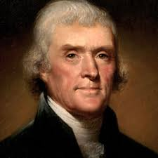
First attempt [MPW’15],[DM’15]
All 4-cliques are created equal!
Make $\tilde{E}[x_{V}]$ the same for all 4-cliques $V$
Works for $k$ up to $n^{\frac{1}{3}}$ or so, this is tight by an argument of Kelner
We want $k$to be almost $\sqrt{n}$

Slide 48
Why Optimist’s Bluff Fails
All 4-cliques are created equal, but some are more equal than others.

Slide 49
Planted Distribution
Useful to consider a planted distribution of actual solutions
Start with a random graph $G$, then make $k$ random vertices into a clique by adding all edges between them
Set $x_{V}=1$ if $V⊆clique$, 0 otherwise

Slide 50
Possible Distinguishing Test
For an average 4-clique $V$ contained within the planted clique, how many 5-cliques is it contained in (in all of $G$)?
Random $G$ under first $\tilde{E}$: $\frac{n−4}{16}$
Planted distribution: $\left(k−4\right)+\frac{n−k}{16}$
This is a significant difference for large $k$!
w
V

Slide 51
Attempt 2: [HKPRS’16]
Respond to the test by giving higher value to $\tilde{E}[x_{V}]$ for $V$ which are contained in more 5-cliques (oversimplification of what we do, but gives the idea)
Works for degree 4, but how can this be generalized and extended to higher degrees?

Slide 52
Pseudo-calibration [BHKKMP’16]
Pseudo-calibration: $\tilde{E}$ should match the planted distribution in expectation for all low degree tests.
Applies to general planted problems and essentially completely determines $\tilde{E}!$

Slide 53
Part V: Brief Proof Overview

Slide 54
The Moment Matrix
$$q$$
p,q are monomials of degree at most $\frac{d}{2}$.
$$p$$
Ẽ[p$q]$
$$M$$
Indexed by monomials of degree $≤\frac{d}{2}$
$M_{pq}=\tilde{E}[pq]$
Each $g$ of degree $≤\frac{d}{2}$ corresponds to a vector
$\tilde{E}\left[g^{2}\right]=g^{T}Mg$
$∀g,\tilde{E}\left[g^{2}\right]≥0$ $⇔$ $M$ is positive semidefinite

Slide 55
Lower Bound Strategy for SoS
Construct pseudo-expectation values $Ẽ$ using pseudo-calibration.
Show that $Ẽ$ obeys the required equalities and that the corresponding moment matrix $M$ is PSD (positive semidefinite)
Construct $\tilde{E}$
Degree d SoS:
NO
NO
YES
$∃$ degree d SOS proof of infeasibility
$∃$ degree d pseudo-expectation values

Slide 56
First Lower Bound
Want to show that the moment matrix $M$ is PSD (positive semi-definite) with high probability.
One method: Write $M=E\left[M\right]+R$, show that $E\left[M\right]≽cId$ and $\left\|R\right\|≤c$ with high probability.
Difficulty: $R$ has random, dependent entries.
Technical part of [MPW’15]: Analyzing $R$

Slide 57
Better $M$, Better Analysis of $M$
[DM’15]: More sophisticated analysis of $M$ (with Schur complements)
[HKPRS’16]: Chose a better $M$ (passes the 5-clique test)
[BHKKMP’16]:
Found the proper $M$ to use with pseudo-calibration
Carefully found a PSD approximation $M≈LQL^{T}$ where $Q≽\left(1−ε\right)Id$ with high probability.
Carefully analyzed the error $M−LQL^{T}$.

Slide 58
Graph Matrices
Graph matrices: entries are random but not independent, dependence on $G$ is described by a small graph $H$.
Appear naturally in analyzing SoS, may be of independent interest
[MP’16]: Rough norm bounds on all graph matrices
U
H
V

Slide 59
Decomposition of Graph Matrices
Graph matrices can be approximately decomposed based on their leftmost and rightmost minimal vertex separators.
S
T
U
H
V

Slide 60
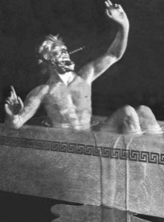
Summary
The sum of squares hierarchy is broadly applicable, effective, and in some sense, simple
Conjectured to be optimal for many problems. If so, for these problems, no longer need ingenuity in coming up with algorithms!
However, performance of SoS is only partially understood
Still need ingenuity in analyzing SoS!

Slide 61
Summary of Results
Developed a general method, pseudo-calibration, for constructing pseudo-expectation values $\tilde{E}$ for planted problems.
Developed powerful machinery for analyzing the corresponding moment matrix $M$ and showing it is PSD with high probability.
With this machinery, proved tight SoS lower bounds for planted clique. Tight bounds for tensor PCA, and sparse PCA and more general lower bound conditions are upcoming

Slide 62
Part VII: Future Work on SoS

Slide 63
Extending Planted Lower Bounds
We’ve generalized the planted clique lower bound considerably, but plenty of work remains.
Can we prove similar lower bounds on problems for sparse graphs?
Densest k-subgraph
Independent set on sparse graphs

Slide 64
Understanding SoS Performance
Can we better understand the performance of SoS on some of the problems where we know it’s effective, but not exactly how effective it is?
Tensor completion and tensor decomposition
Planted sparse vector
Max-cut
Sparsest cut
Unique games (Major open problem)

Slide 65
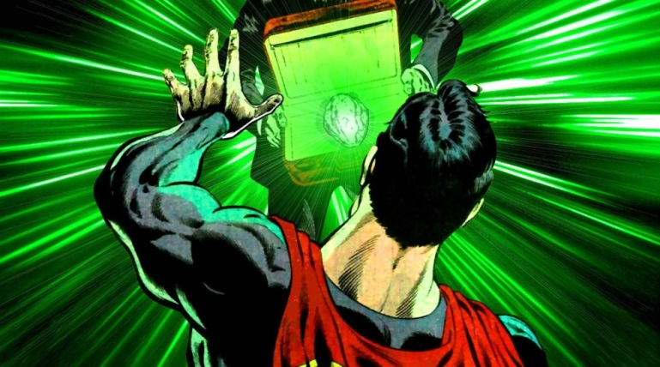
Power/Limitations of SoS
Power of SoS:
What other applications of SoS are there?
Hopefully you’ll tell me!
Limitations of SoS:
We only know of a few techniques SoS cannot capture:
Gaussian elimination
Probabilistic method
Integrality arguments
What else can’t SoS capture?

Slide 66
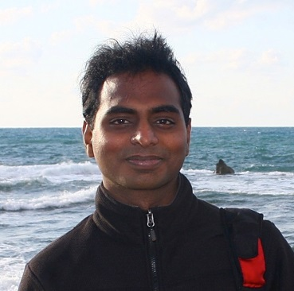
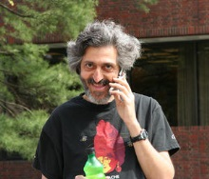
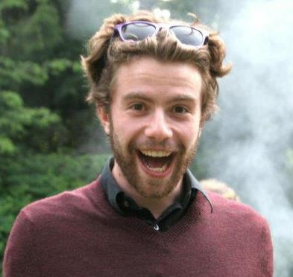
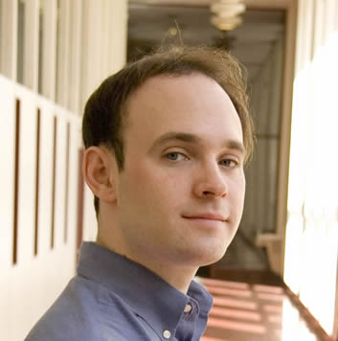
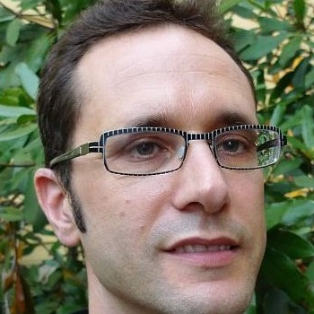
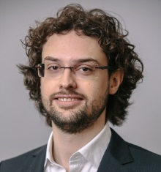
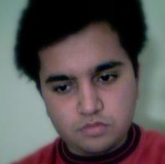
Acknowledgements

Slide 67
Thank you!

Slide 68
Supplementary Slides

Slide 69
Tensor and Sparse PCA

Slide 70
Tensor PCA (Single Spike Model)
Random instance: $T_{abc}=N(0,1)$ (Gaussian random variable)
Planted instance: $T_{abc}=N\left(0,1\right)+{αv}_{a}v_{b}v_{c}$ for some unit vector $v$ and signal-to-noise parameter $α$.

Slide 71
Sparse PCA
Random Instance: m random samples from a multivariable Gaussian with covariance matrix $Id$
Planted instance: m random samples from a multivariable Gaussian with covariance matrix $Id+αvv^{T}$ for some k-sparse unit vector $v$ and parameter $α$

Slide 72
Further Details for SoS hierarchy

Slide 73
Questions on SoS
Degree $d$ SoS hierarchy: Returns NO if there is a degree $d$ SoS proof of infeasibility, returns YES if there are degree $d$ pseudo-expectation values.
Question 1: Does an SoS proof of infeasibility always exist (if the equations are infeasible)?
Question 2: How can we find pseudo-expectation values efficiently?
Question 3: How can we use SoS for optimization and for approximation algorithms?
Question 4: How high do we need $d$ to be to ensure degree $d$ SOS is accurate?

Slide 74
Existence of SoS Proofs
Question 1: When the equations are infeasible, does an SoS proof always exist?
Closely related to Hilbert’s 17th problem
Stengle’s Positivstellensatz: YES. If equations are infeasible, $∃$ SoS proof of infeasibility.
However, degree could be doubly exponential.
Degree d SoS:
NO
NO
YES
$∃$ degree d SoS proof of infeasibility
$∃$ degree d pseudo-expectation values
$$d→∞$$

Slide 75
Semidefinite Programs for SoS
Question 2: How can we find pseudo-expectation values efficiently?
Can search for the pseudo-expectation values $\tilde{E}$ with a semidefinite program of size $n^{O(d)}$.
Matrix entries will be the values of $\tilde{E}[p]$ for monomials $p$ of degree $≤d$.
SoS gives a hierarchy of increasingly powerful (and large) semidefinite programs

Slide 76
The Moment Matrix
$$q$$
p,q are monomials of degree at most $\frac{d}{2}$.
$$p$$
Ẽ[p$q]$
$$M$$
Indexed by monomials of degree $≤\frac{d}{2}$
$M_{pq}=\tilde{E}[pq]$
Each $f$ of degree $≤\frac{d}{2}$ corresponds to a vector
$\tilde{E}\left[f^{2}\right]=f^{T}Mf$
$\tilde{E}$ is nonnegative on squares $⇔$ $M≽0$

Slide 77
Optimization with SoS
Question 3: How can we use SoS for optimization and approximation algorithms?
Equations often have parameter(s) we are trying to optimize
Example:
$∀i,x_{i}^{2}$ = $x_{i}$
$x_{i}$ $x_{j}$ = 0 if $\left(i,j\right)∉E\left(G\right)$
$\sum_{i}{x_{i}}$ = $k$
Can use SoS to estimate the optimal value of $k$

Slide 78
Optimization with SoS
Want to optimize parameters (such as k) over green region, SOS optimizes over the blue and green regions.
As we increase the degree, the blue region shrinks
Equations are feasible
Infeasible but no proof
Positivstellensatz proof of infeasibility

Slide 79
Approximation Algorithms with SoS
If there is a method for rounding the pseudo-expectation values $Ẽ$ into an actual solution (with worse parameters), this gives an approximation algorithm.
Optimal Solution
Equations are feasible
$$Ẽ$$
A Solution
Infeasible but no proof
Positivstellensatz proof of infeasibility

Slide 80
What degree do we need?
Question 4: How high do we need $d$ to be to ensure degree $d$ SOS is accurate?
Depends on the problem, this is the fundamental research question about SoS!
[BHKKMP’16]: SoS requires* degree $Ω(\log{n)}$ to be accurate on k-clique for random graphs
*: For technical reasons, proof relaxes the constraint $\sum_{i}{x_{i}}=k$ to $\sum_{i}{x_{i}}≈k$

Slide 81
Calculation for Pseudo-Calibration

Slide 82
Pseudo-calibration
Pseudo-calibration: $\tilde{E}$ should match the planted distribution in expectation for all low degree tests.

Slide 83
Planted Distribution
Start with a random graph $G$, then put each vertex $i$ in the planted clique with probability $\frac{ω}{n},$ adding all edges between these vertices to $G$.
Definition: Define $x_{V}=\prod_{i∈V}{x_{i}}$
Set $x_{V}=1$ if $V⊆clique$, 0 otherwise
Note: This planted distribution only approximately satisfies the constraint $\sum_{i}{x_{i}}$ = $ω$.

Slide 84
Fourier Characters $χ_{E}$
Definition: Given a set $E$ of possible edges of $G$, define $χ_{E}\left(G\right)=−1^{|E∖E(G)|}$
$$x_{1}$$
$$x_{2}$$
$$x_{1}$$
$$x_{2}$$
$$x_{1}$$
$$x_{2}$$
$$x_{4}$$
$$x_{3}$$
$$x_{4}$$
$$x_{3}$$
$$x_{4}$$
$$x_{3}$$
$$E$$
$$G$$
$$E∖E(G)$$
Example: If $E=\{\left(x_{1},x_{2}\right),\left(x_{1},x_{3}\right),(x_{1},x_{4})\}$ then $χ_{E}\left(G\right)=−1$ as $\left|E∖E\left(G\right)\right|=1$

Slide 85
Pseudo-calibration
For all small $V,E$, $E_{G∼G\left(n,\frac{1}{2}\right)}\left[χ_{E}\tilde{E}[x_{V}]\right]=E_{G,x∼G\left(n,\frac{1}{2}\right)+K_{ω}}[x_{V}χ_{E}]$
Right hand side is 0 (over the random part of G) unless $V∪V\left(E\right)⊆clique$, in which case the right hand side is 1.
Each vertex is in the clique with probability $\frac{ω}{n}$, so the right hand side has value ${\left(\frac{ω}{n}\right)}^{\left|V\left(E\right)∪V\right|}$

Slide 86
Pseudo-calibrated Moments
$∀V,E, E_{G∼G\left(n,\frac{1}{2}\right)}\left[χ_{E}\tilde{E}[x_{V}]\right]={\left(\frac{ω}{n}\right)}^{|V∪V(E)|}$
Writing $\tilde{E}\left[x_{V}\right]=\sum_{E^{′}}{c_{E^{′}}}χ_{E^{′}}\left(G\right)$, $E_{G∼G\left(n,\frac{1}{2}\right)}\left[χ_{E}\tilde{E}[x_{V}]\right]=c_{E^{′}}={\left(\frac{ω}{n}\right)}^{|V∪V(E)|}$
$\tilde{E}\left[x_{V}\right]=\sum_{E:\left|V\left(E\right)∪V\right|<D}{{\left(\frac{ω}{n}\right)}^{\left|V\left(E\right)∪V\right|}}χ_{E}\left(G\right)$ where $D∼log⁡(n)$ is a truncation parameter.

